Slide 1
Crosslingual Information Retrieval
(CLIR)
Rui Zhang
Sept 25, 2018 @ Advanced NLP

Slide 2
Outline
General IR
Traditional IR Models
Language Problems in IR
Crosslingual IR
Motivation
CLIR by Translation
Three recent papers on Three subtopics
Neural Network for IR
Crosslingual Word Embeddings
Unsupervised CLIR

Slide 3
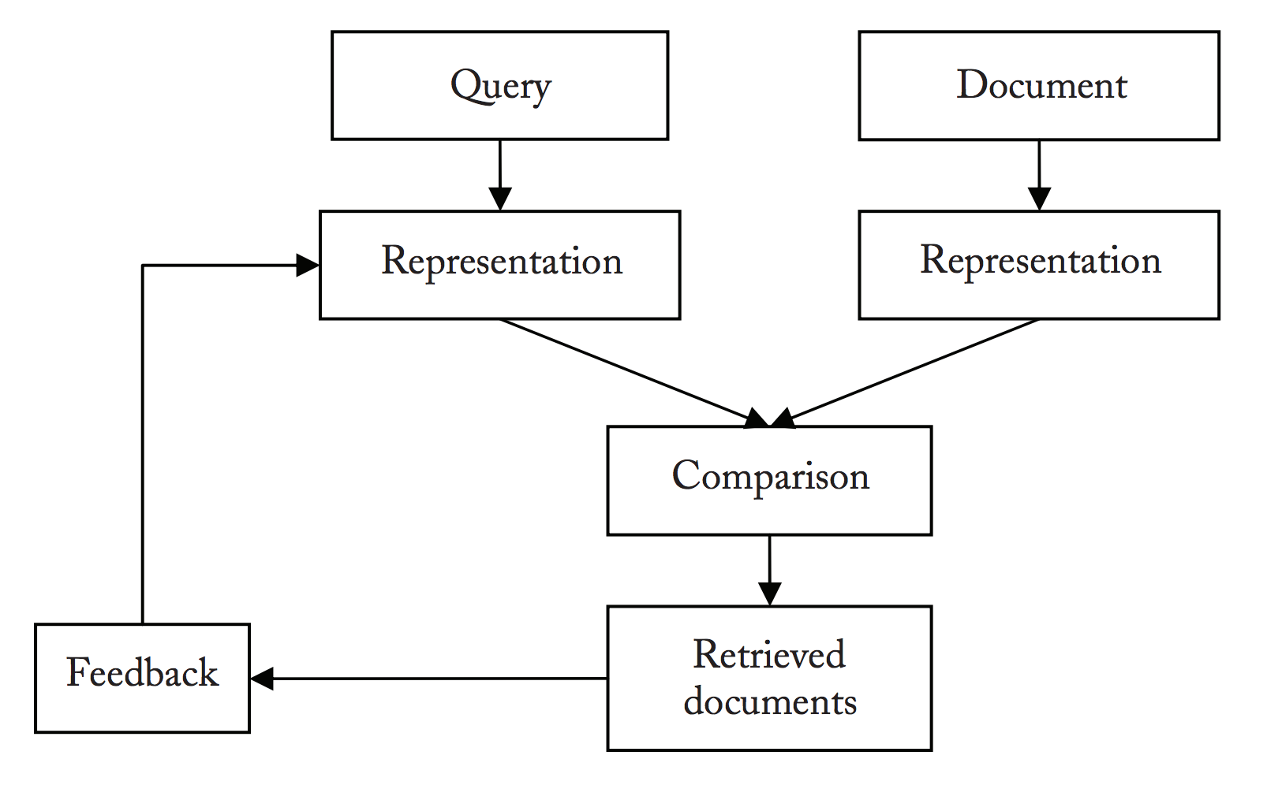
Information Retrieval (IR)
Find relevant information (relevant documents containing such information) for a particular user need.
http://www.iro.umontreal.ca/~nie/IFT6255/Books/CLIR.pdf

Slide 4
Traditional IR Models
Boolean Models
Vector Space Model
Statistical Language Models
Relevance Model
Pseudo Relevance Feedback

Slide 5
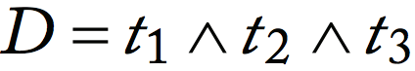
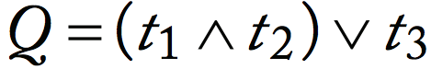
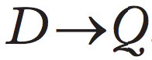
Boolean Models
Document
Query
Relevant if and only if

Slide 6
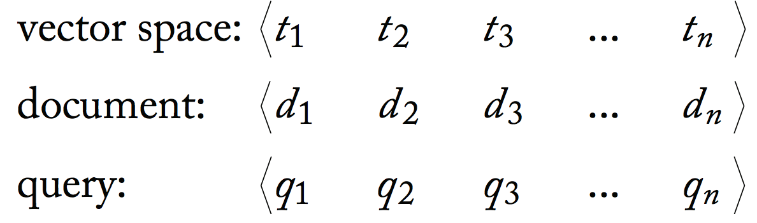
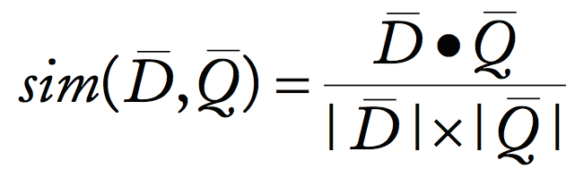
Vector Space Model
Use a vector to represent a document or a query.
Relevance as similarity in the vector space.

Slide 7
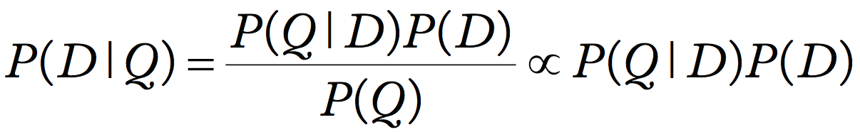
Statistical Language Models
To score a document D given a query Q

Slide 8
Statistical Language Models
To score a document D given a query Q
by Bayes rule

Slide 9
Statistical Language Models
To score a document D given a query Q
by Bayes rule
P(Q) is not important because we only care about the ranking of D

Slide 10
Statistical Language Models
To score a document D given a query Q
by Bayes rule
P(Q) is not important because we only care about the ranking of D
assume P(D) is the same for all documents

Slide 11
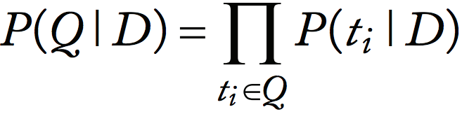
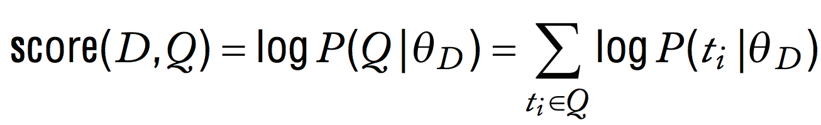
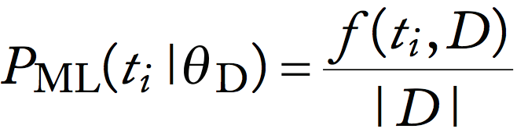
Statistical Language Models
Assume independence between terms
Use a unigram language model given by D to score Q
The language model can be estimated via Maximum Likelihood (ML)

Slide 12
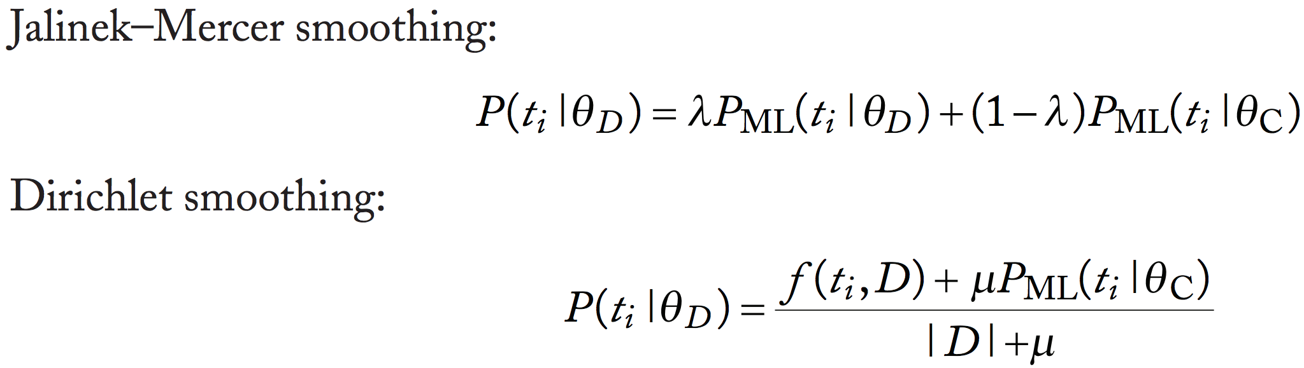
Statistical Language Models
The language model can be estimated via Maximum Likelihood (ML)
But suffer from sparsity
The score is 0 if a query term does not appear in D, which is too strict.
Add smoothing from the language model estimated on the whole collection C

Slide 13
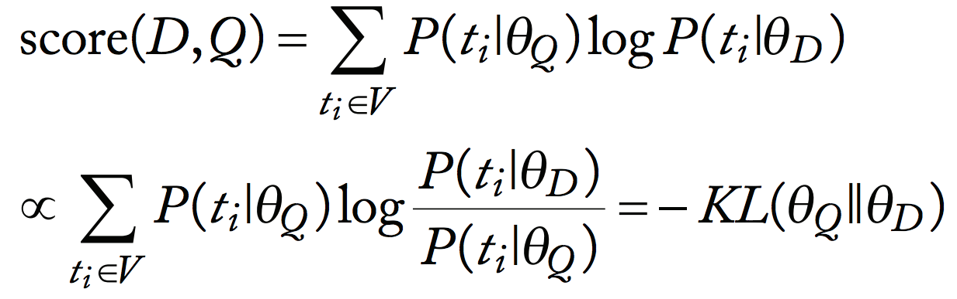
Relevance Model and Pseudo Relevance Feedback
Relance Model
Score as the negative KL divergence between two language models given by Q and D.
KL divergence is small -> two language models are close -> score is large
How to estimate language model Q ?
ML without Smoothing
Also use the documents retrieved at first round: Pseudo Relevance Feedback

Slide 14
Language Problems in IR
European Languages (English, French, ...)
Word Stemming: Discard meaningless morphological variations
the boy's cars are different colors =>
the boy car be differ color
Word Decompounding: Complex words can be compounded from simpler words
hungerstreiks => hunger (hunger), streiks (strikes)
https://nlp.stanford.edu/IR-book/html/htmledition/stemming-and-lemmatization-1.html

Slide 15

Language Problems in IR
East Asian Languages (Chinese, Japanese, ...)
Word Segmentation: find word boundary due to the absence of space to delimit words.
http://www.iro.umontreal.ca/~nie/IFT6255/Books/CLIR.pdf

Slide 16
Crosslingual Information Retrieval (CLIR)
Retrieve information in a language different from the language of the query.
Retrieve documents written in French or Chinese with a query written in English

Slide 17
Crosslingual Information Retrieval (CLIR)
Why?
The desired information does not exist in the native language.
An English speaker traveling in the Philippines wants to find information about local food.
The user wants to find all the relevant information regardless of the language is used.
Patent Retrieval
Many users can understand more than one language.

Slide 18
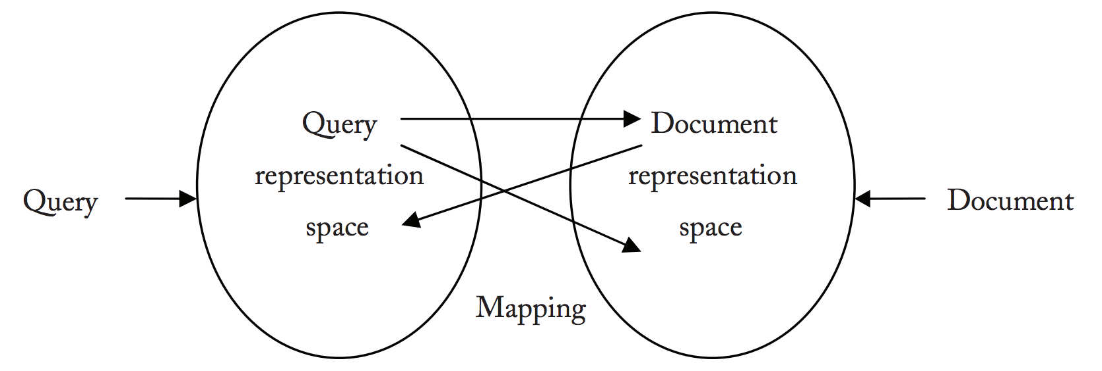
Mapping
Develop tools to match such terms in different languages that describe the same or a similar meaning.
http://www.iro.umontreal.ca/~nie/IFT6255/Books/CLIR.pdf

Slide 19
CLIR by Translation
Document translation
Mapping the document representation into the query representation space
Query translation
Mapping the query representation into the document representation space
Pivot language or interlingua
Mapping both document and query representations to a third space

Slide 20
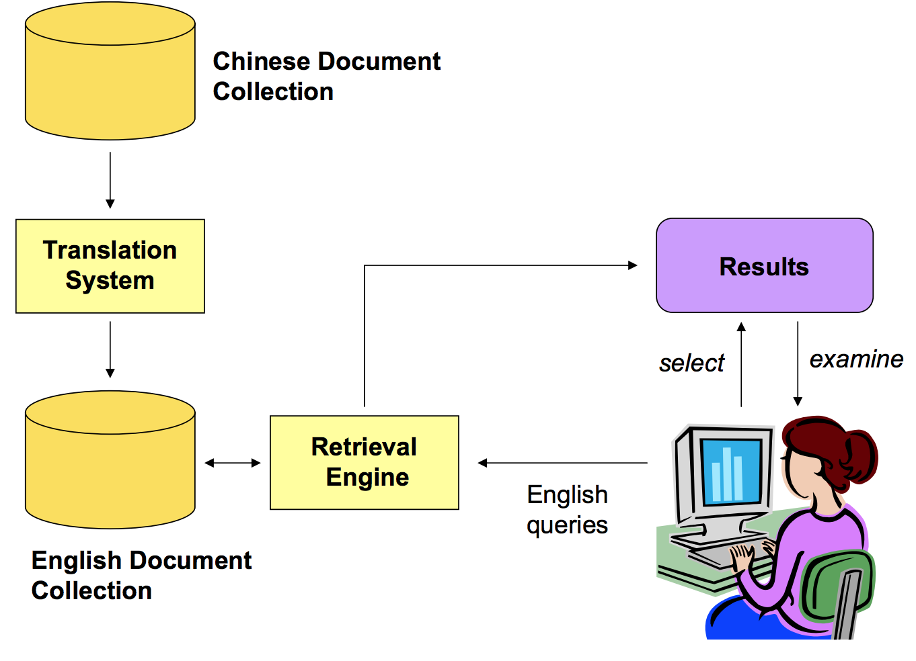
Document Translation
http://www.ccs.neu.edu/home/jaa/IS4200.12S/Handouts/cross_language.pdf

Slide 21
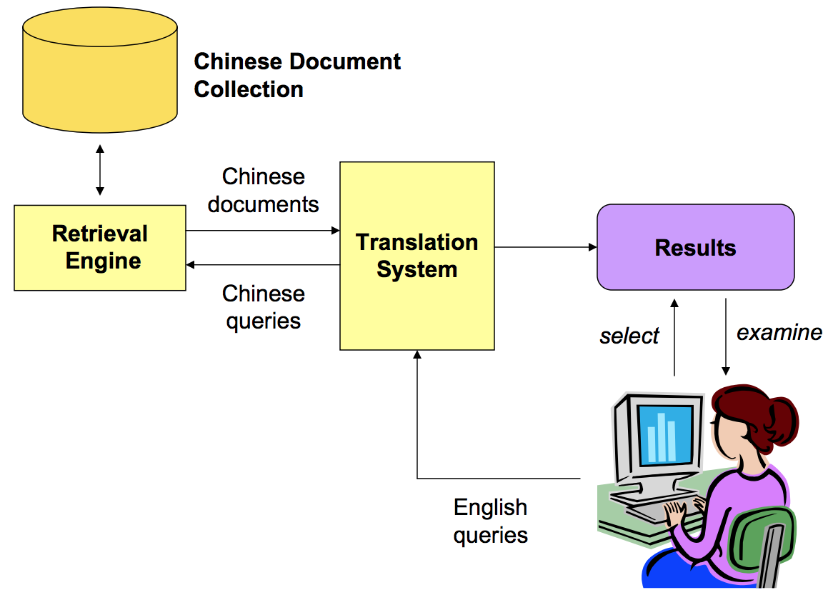
Query Translation
http://www.ccs.neu.edu/home/jaa/IS4200.12S/Handouts/cross_language.pdf

Slide 22
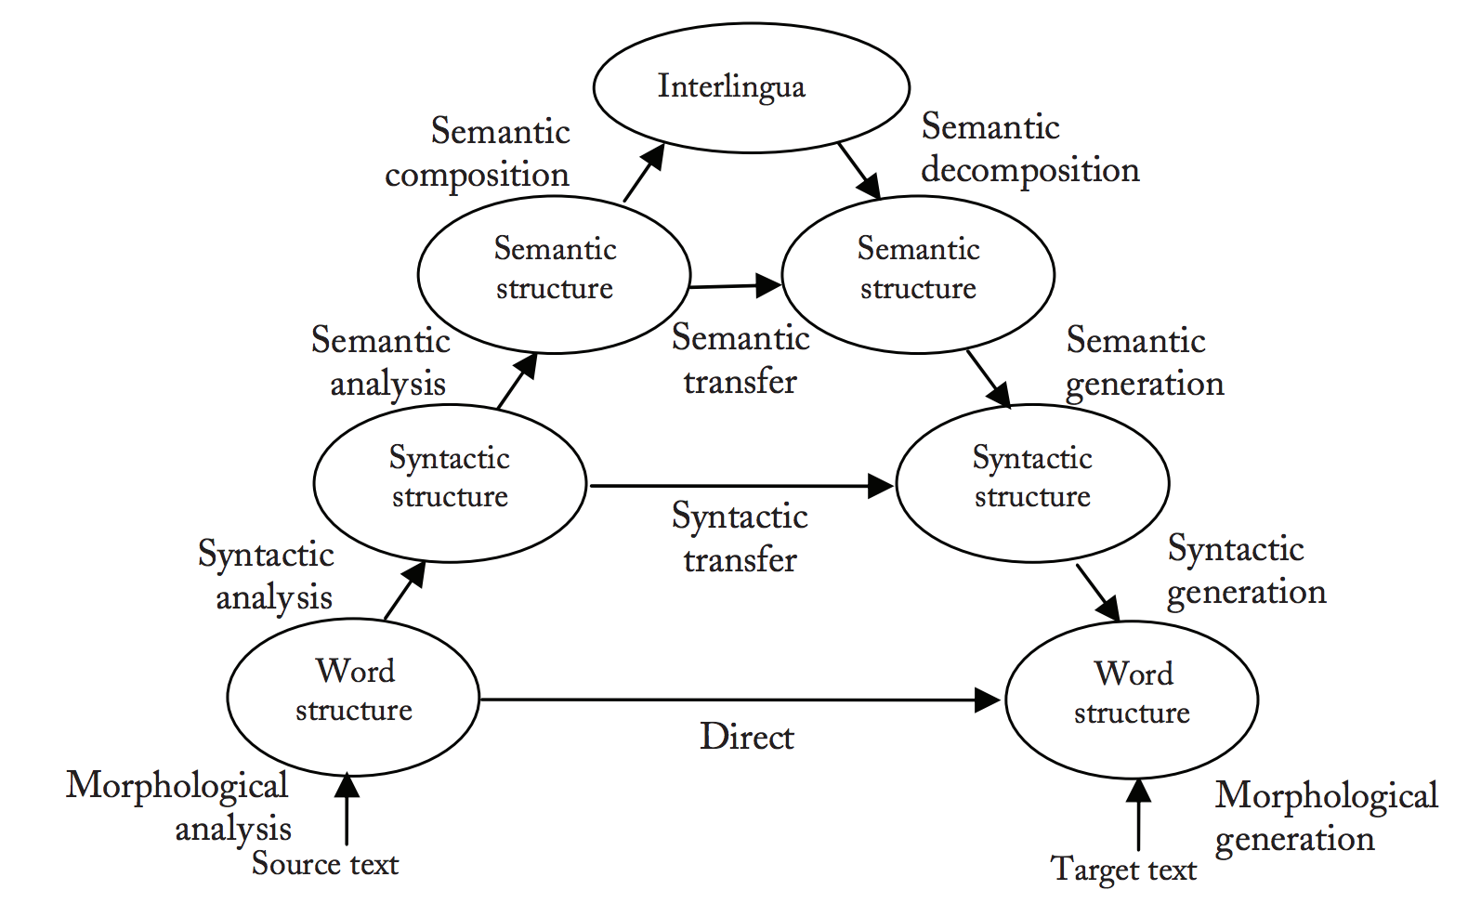
Pivot language or interlingua
Vauquois Triangle
http://www.iro.umontreal.ca/~nie/IFT6255/Books/CLIR.pdf

Slide 23
Document Translation vs Query Translation
Document Translation
Documents can be translated and stored offline
Automatic translation can be slow
Richer contexts to avoid translation ambiguity
Query Translation
Easy and Fast
Difficult disambiguation of query terms with short queries
Need to translate documents retrieved at query time

Slide 24
Cutting Edges - Three papers on Three subtopics
1. DUET Learning to Match using Local and Distributed Representations of Text for Web Search (WWW 2017) [code]
Learning to Rank Documents using Neural Networks (Monolingual IR)
2. MUSE Word Translation Without Parallel Data (ICLR 2018) [code]
Multilingual Word Embedding in the Same Space
3. Unsupervised Cross-Lingual Information Retrieval using Monolingual Data Only (SIGIR 2018) [code]
Use MUSE for CLIR

Slide 25
Learning to Match using Local and Distributed Representations of Text for Web Search (DUET)
Bhaskar Mitra, Fernando Diaz, and Nick Craswell
WWW 2017

Slide 26
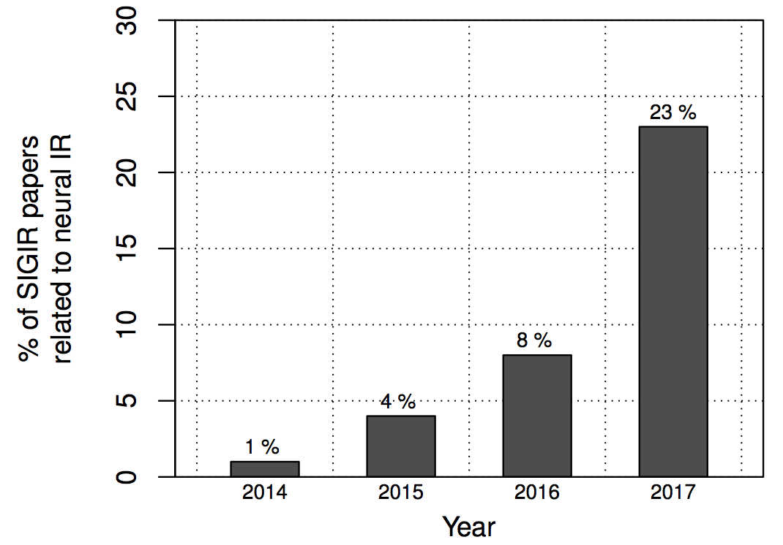

Neural Information Retrieval
Neural IR is the application of shallow or deep neural networks to IR tasks.
https://www.microsoft.com/en-us/research/wp-content/uploads/2017/06/fntir-neuralir-mitra.pdf

Slide 27
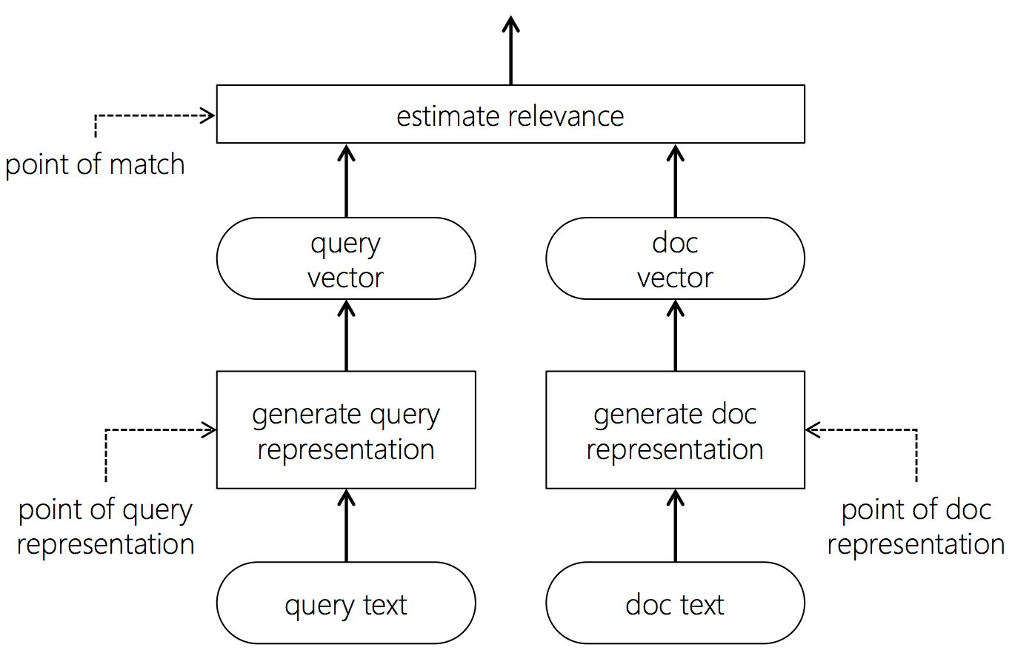
Neural IR in Three Steps
Neural IR in three steps
Generate Query Representation
Generate Document Representation
Estimate relevance
https://www.microsoft.com/en-us/research/wp-content/uploads/2017/06/fntir-neuralir-mitra.pdf

Slide 28
DUET: A tale of two representations
Consider a Query
What Channel SEAHAWKS on today

Slide 29
DUET: A tale of two representations
Consider a Query
What Channel SEAHAWKS on today
Rare term
The target document needs to contain the exact term "Seahawks", rather than "Patriots".
Learn a neural model to estimate the relevance from patterns of exact matches

Slide 30
DUET: A tale of two representations
Consider a Query
What Channel SEAHAWKS on today
Rare term
The target document needs to contain the exact term "Seahawks", rather than "Patriots".
Learn a neural model to estimate the relevance from patterns of exact matches
Target document contains "ESPN" or "SKY Sports" instead of "Channel".
An embedding can associate "ESPN" in the document and "Channel" in the query.
Learn embeddings of text and match query with document in the embedding space.

Slide 31
DUET: A tale of two representations
Consider a Query
What Channel SEAHAWKS on today
Rare term
The target document needs to contain the exact term "Seahawks", rather than "Patriots".
Learn a neural model to estimate the relevance from patterns of exact matches
Target document contains "ESPN" or "SKY Sports" instead of "Channel".
An embedding can associate "ESPN" in the document and "Channel" in the query.
Learn embeddings of text and match query with document in the embedding space.
DUET: Use neural networks to model both functions and learn their parameters jointly

Slide 32
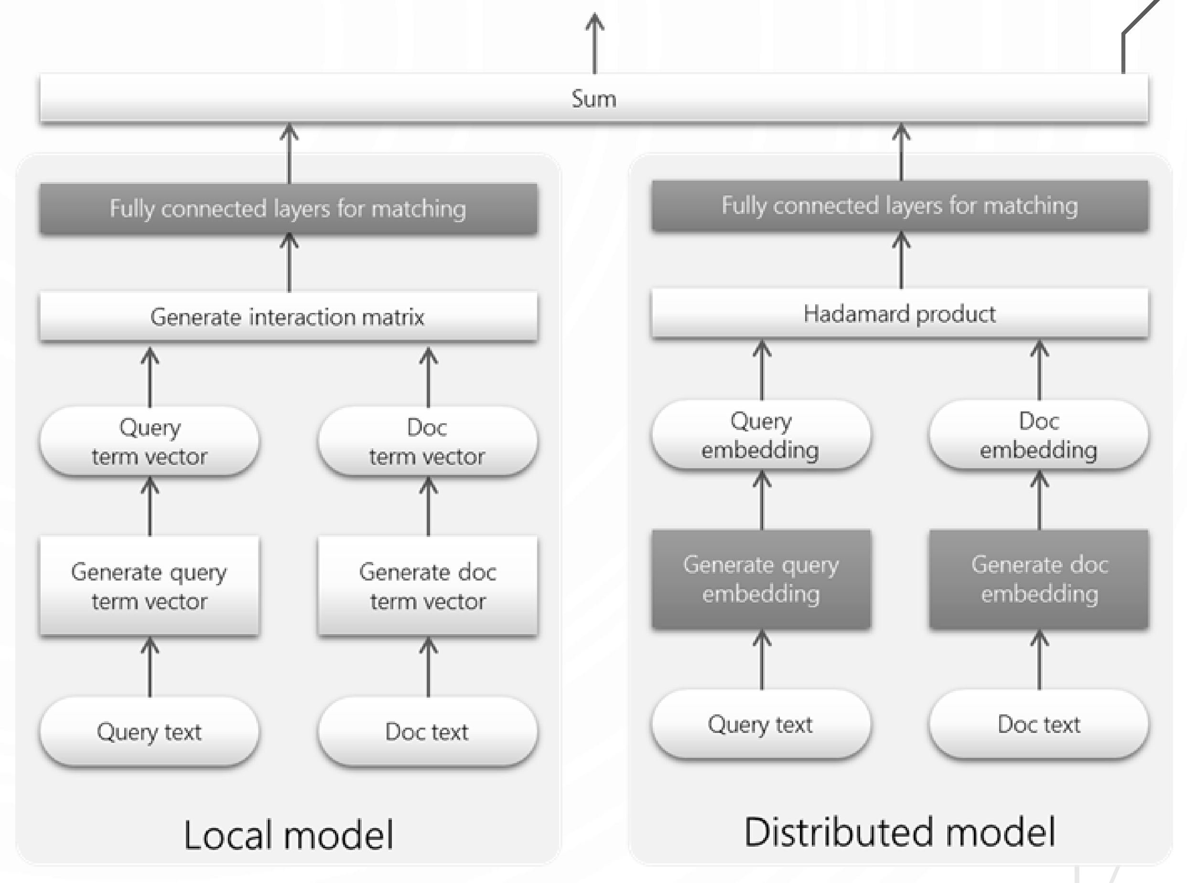
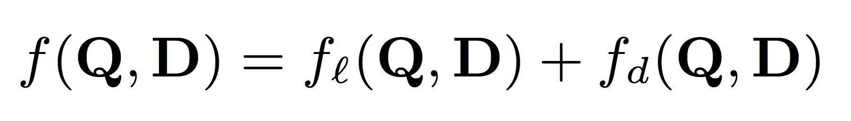
The DUET Architecture
Local Model + Distributed Model

Slide 33
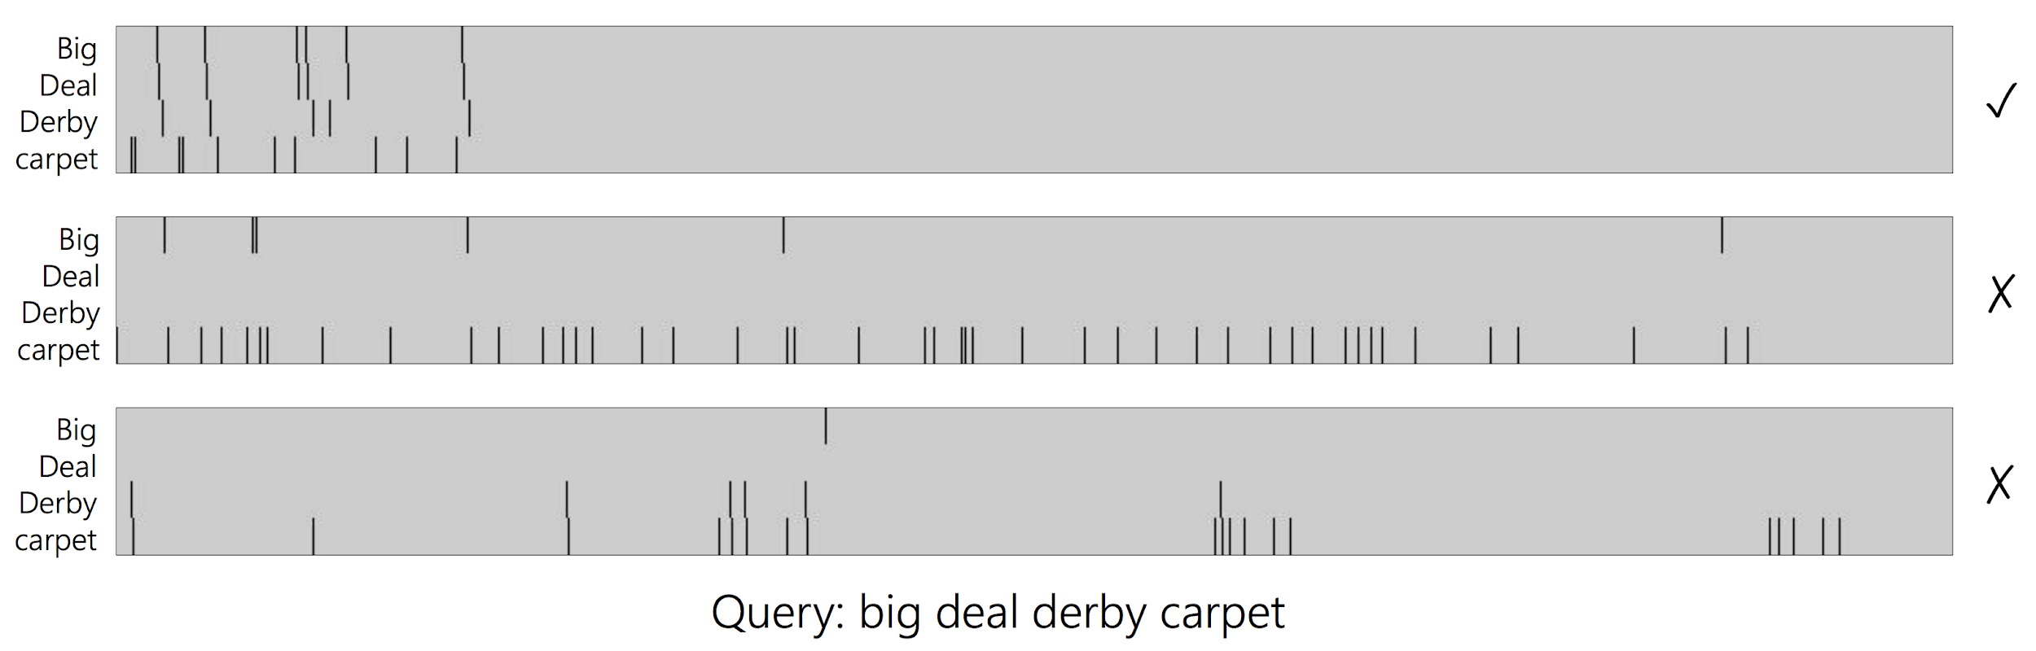
Local Model
Focus on patterns of exact matches of query terms in document.
Use the interaction matrix as input.

Slide 34
Local Model
Focus on patterns of exact matches of query terms in document.
Use the interaction matrix as input.
Many matches
Matches early in document
Matches for all query terms
In-order (phrasal) matches

Slide 35
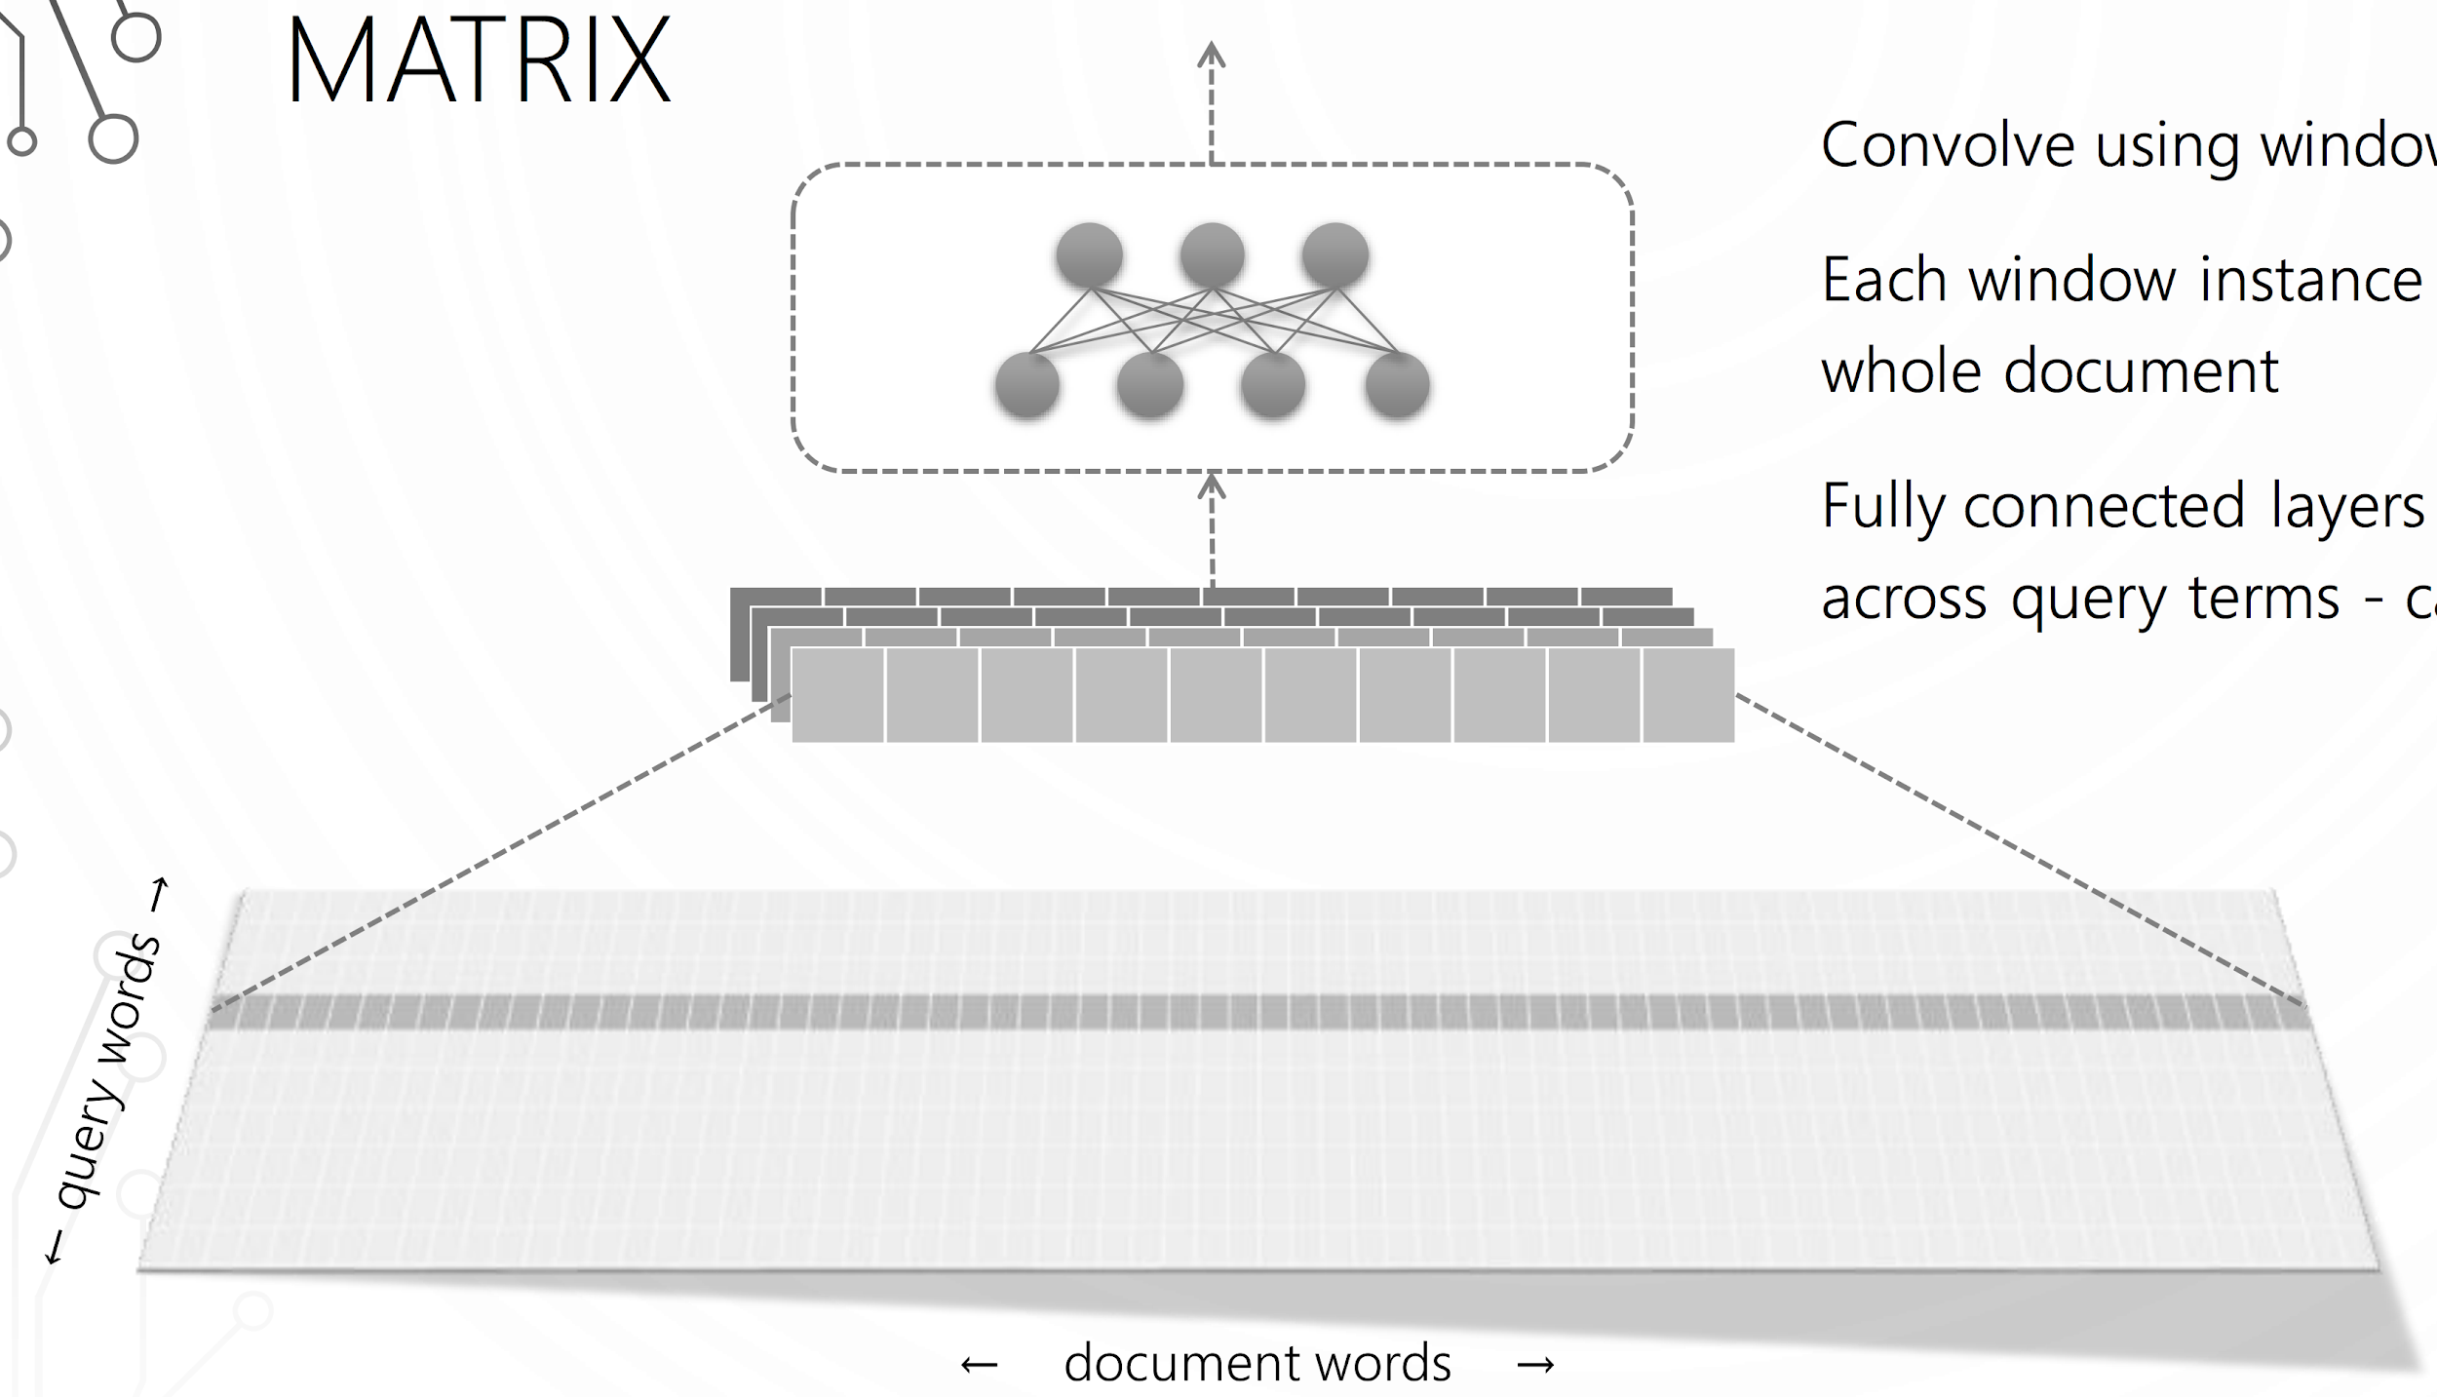
Local Model - CNN + Fully Connected Layer
https://www.microsoft.com/en-us/research/uploads/prod/2018/04/NeuralIR-Nov2017.pdf

Slide 36
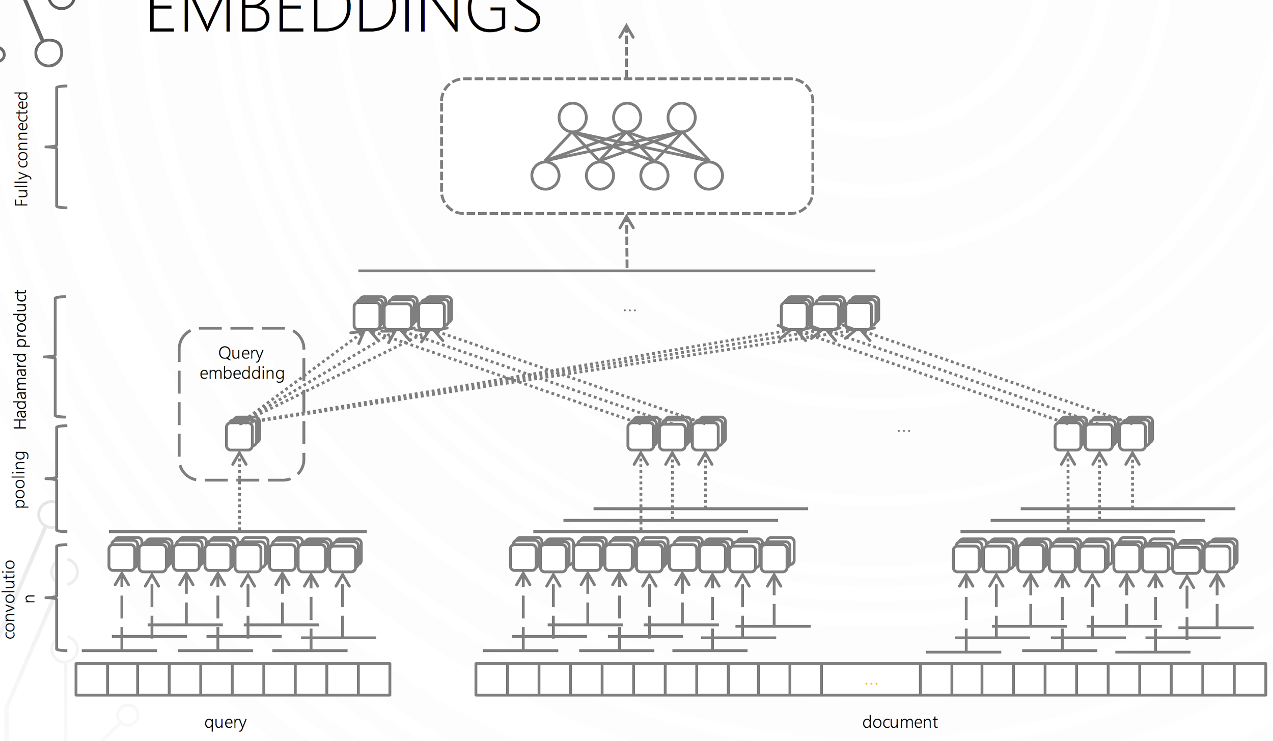
Distributed Model
https://www.microsoft.com/en-us/research/uploads/prod/2018/04/NeuralIR-Nov2017.pdf

Slide 37
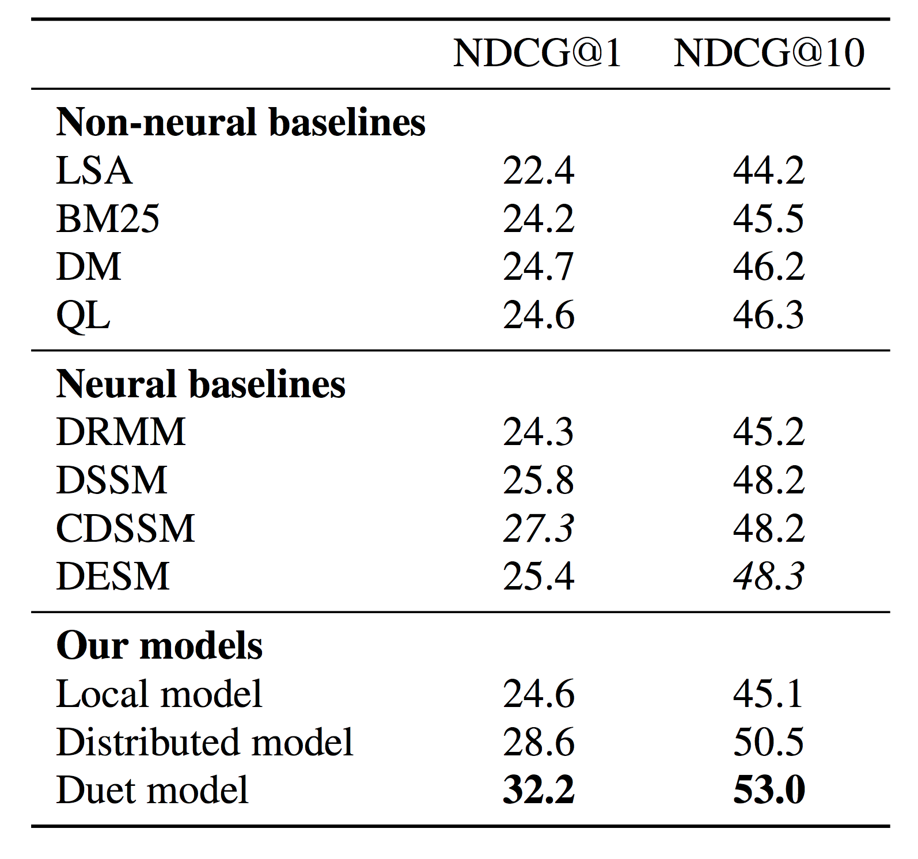
Result
199,753 (Q,D) from the Bing search engine

Slide 38
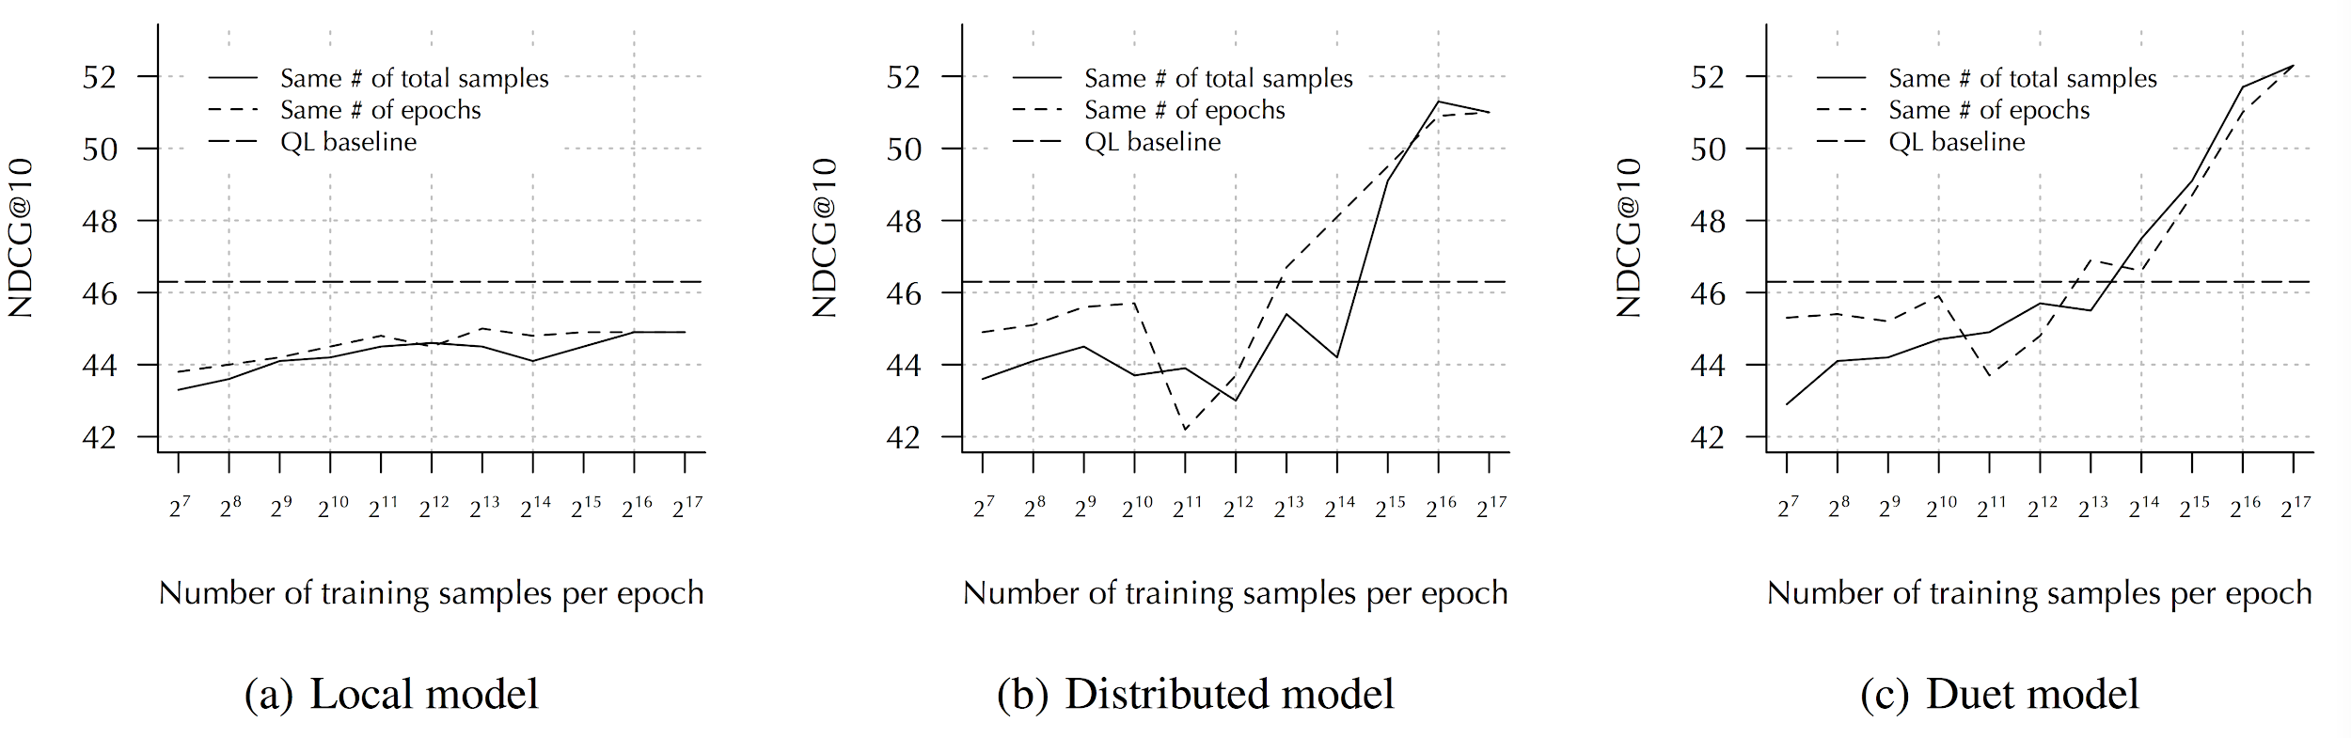
Effect of Training Data Size
199,753 (Q,D) from the Bing search engine
The distributed model benefits a lot from more training data, while the local model does not.

Slide 39
Word Translation Without Parallel Data (MUSE)
Alexis Conneau, Guillaume Lample,
Marc'Aurelio Ranzato, Ludovic Denoyer, Hervé Jégou
ICLR 2018

Slide 40
Overview
Separate word embeddings for individual languages
word2vec, GloVe, ELMo

Slide 41
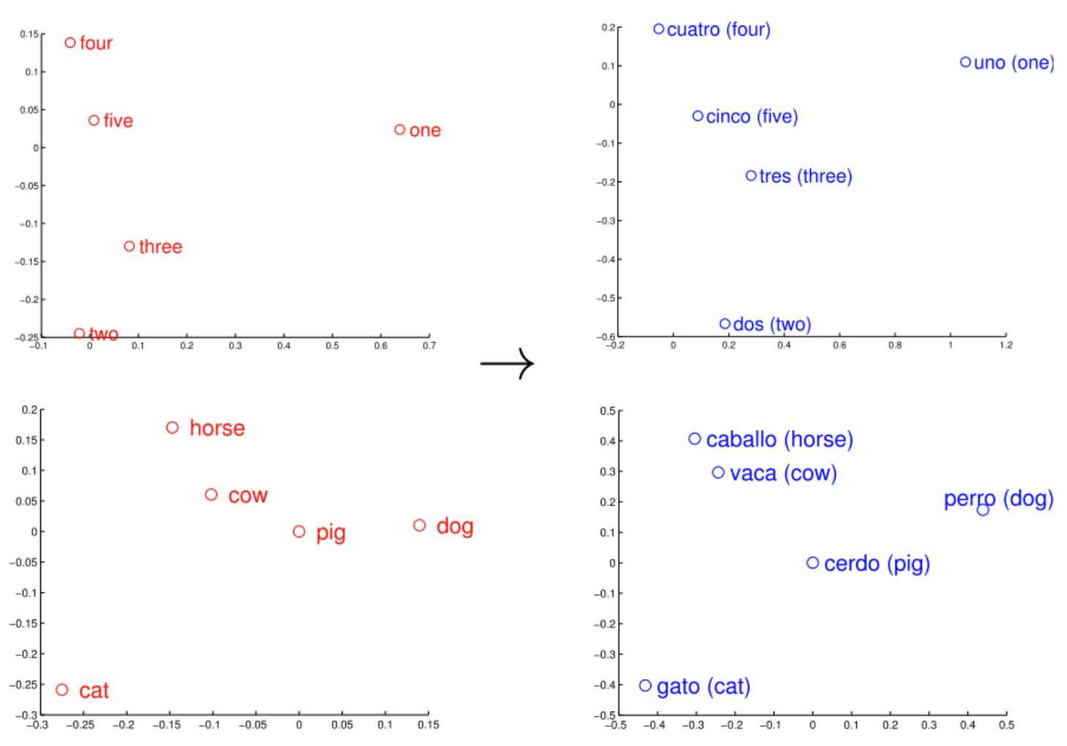
Relation between Two Embedding Spaces
Similar geometric relations between numbers and animals in English and Spanish (Mikolov et al., 2013)

Slide 42
Overview
Separate word embeddings for individual languages
word2vec, GloVe, ELMo
Can we have the same embedding space for two different languages?
Cross-lingual word embeddings
word translation and other downstream multilingual NLP task such as CLIR
Learn a linear mapping from a source to a target embedding space

Slide 43

Mapping between Two Embedding Spaces
https://code.fb.com/ai-research/unsupervised-machine-translation-a-novel-approach-to-provide-fast-accurate-translations-for-more-languages/

Slide 44
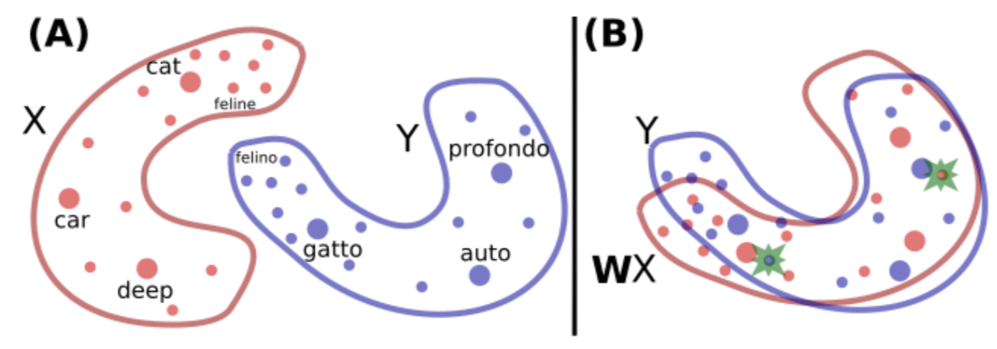
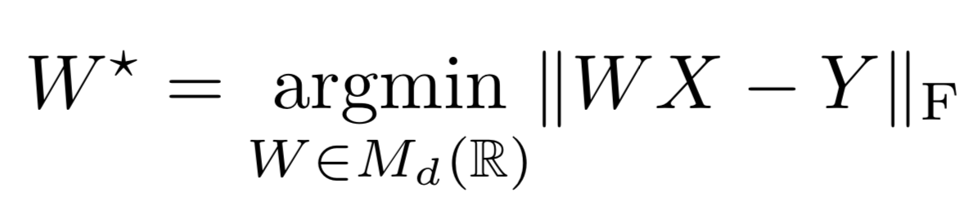
Linear Mapping between Two Embedding Spaces
https://arxiv.org/pdf/1710.04087.pdf

Slide 45
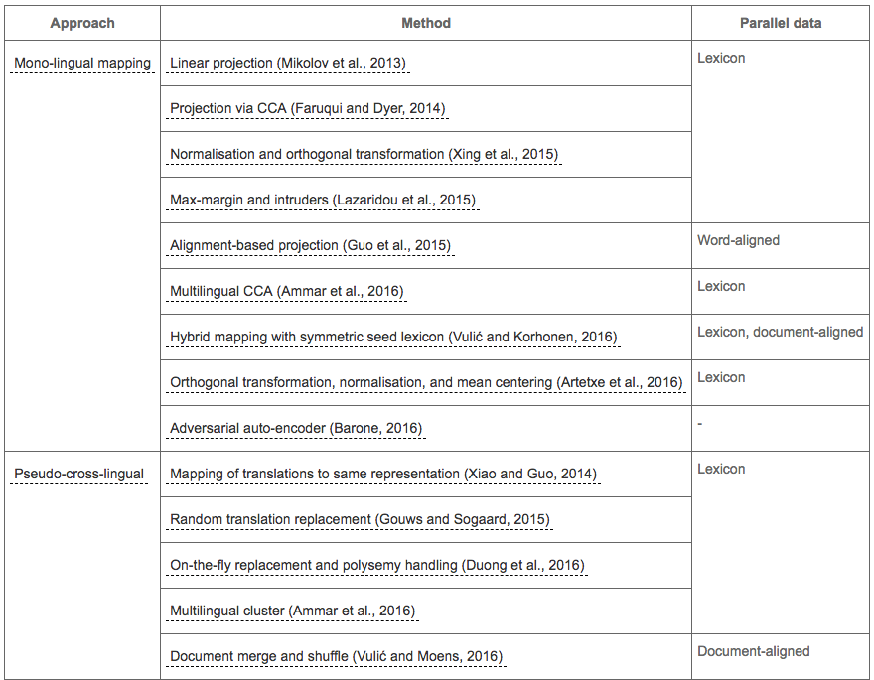
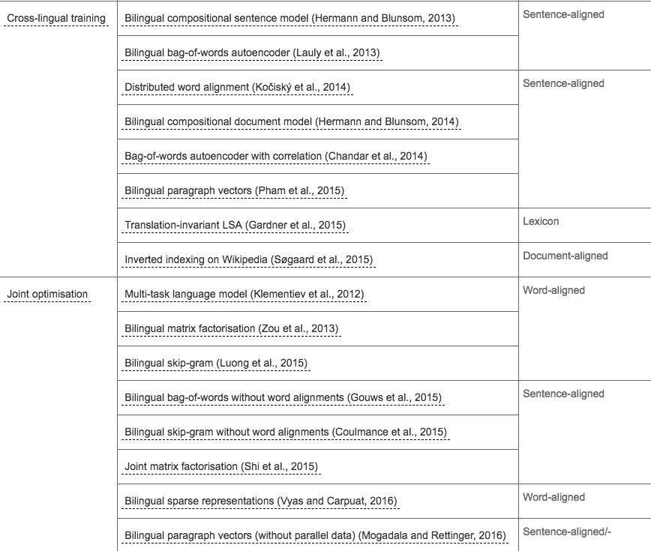
Cross-lingual Word Embedding Models
http://ruder.io/cross-lingual-embeddings/

Slide 46
The Need for Bilingual Supervision
Bilingual Supervision
Mikolov et al. (2013) use 5000 English-Spanish word translation (anchor points).
Less Bilingual Supervision
Smith et al. (2017) employ identical character strings to form a parallel vocabulary.
Artetxe et al. (2017) start from a parallel vocabulary of aligned digits and do iterative mapping.
No Bilingual Supervision
MUSE, but still on par with or outperforms supervised state-of-the-art methods.

Slide 47
An Adversarial Two-Player Game
WX
W: Linear Mapping
D: Discriminator
source or target?
X: source word embedding
Y: target word embedding

Slide 48
An Adversarial Two-Player Game
Discriminative Objective
Distinguish between WX and Y
Linear Mapping Objective
WX is close to Y such that the discriminator cannot distinguish between WX and Y

Slide 49
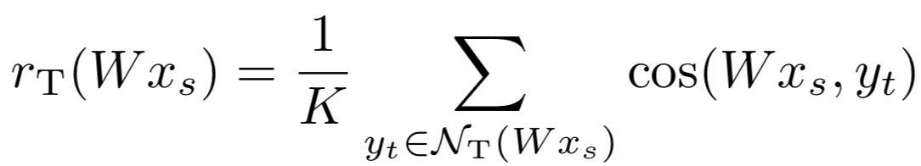
Word Translation
Produce reliable mapping between two languages based on Cosine Similarity
Symmetric: If word y in target is the NN of word x in source, we also want to have x in source is the NN of word y in target.

Slide 50
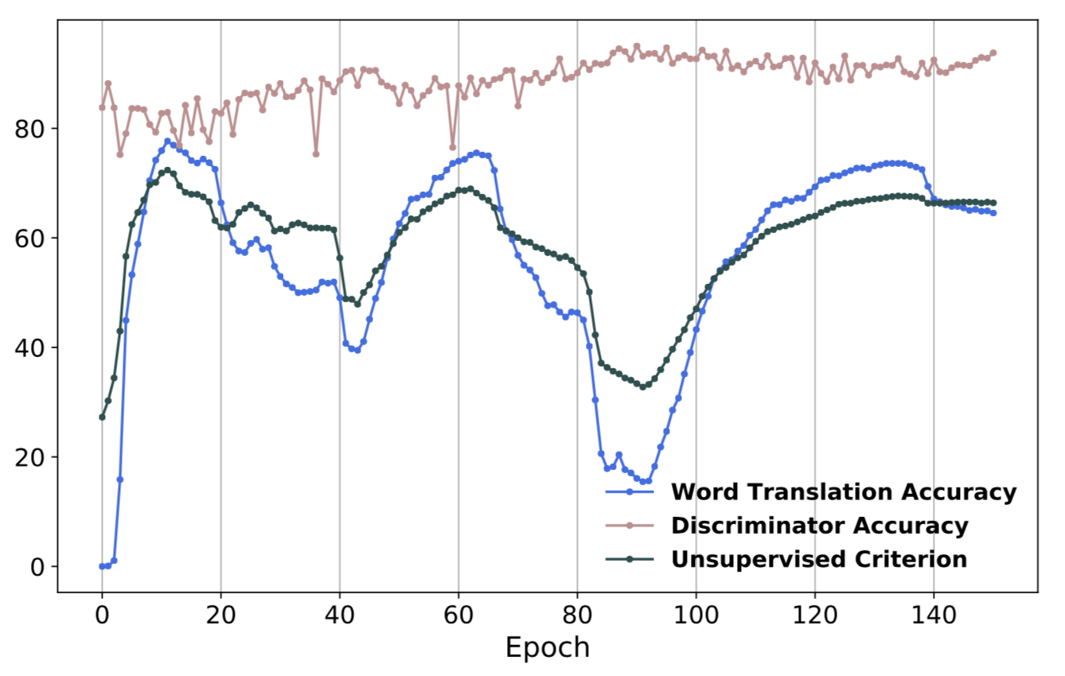
Unsupervised Model Selection
The validation criterion is also unsupervised.
Cannot use bilingual aligned data for stopping the train or hyperparameter selection.
Use 10K most frequent source words and generate a translation using CSLS.
Use their cosine similarity as a surrogate validation metric.
This metric correlates well with the word translation accuracy (see figure).

Slide 51
Evaluation Tasks
Word Translation
Cross-lingual Semantic Word Similarity
Sentence Translation Retrieval

Slide 52
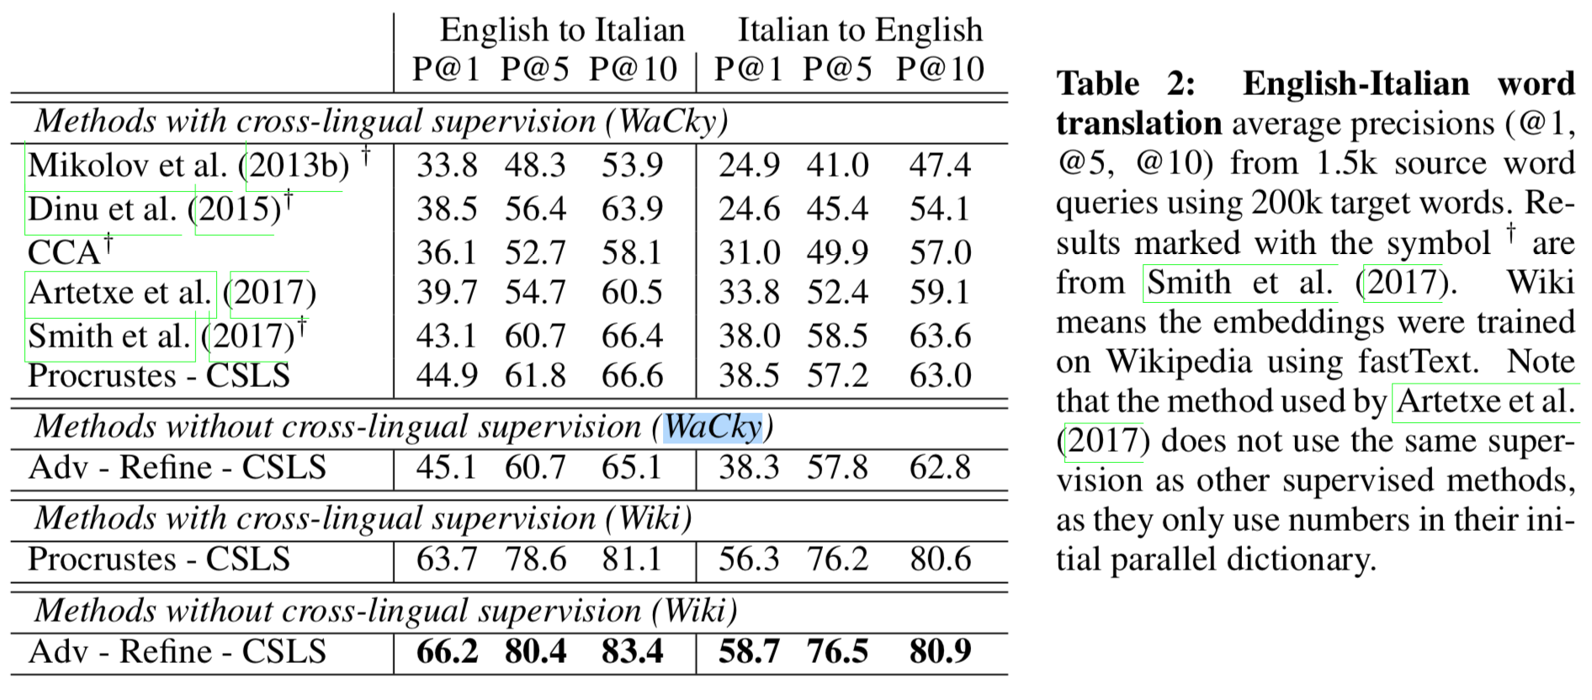
Word Translation

Slide 53
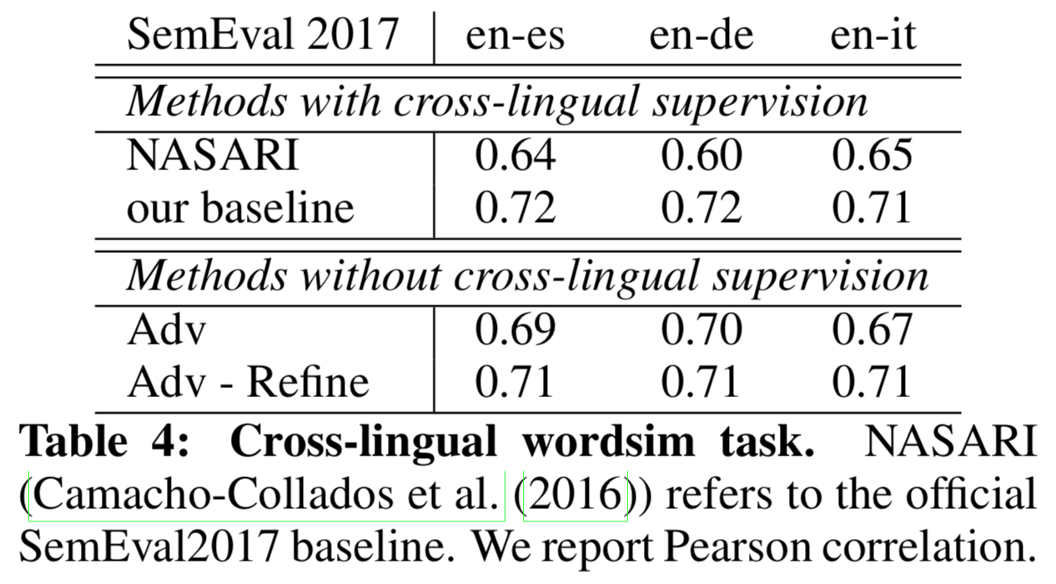
Cross-lingual Semantic Word Similarity

Slide 54
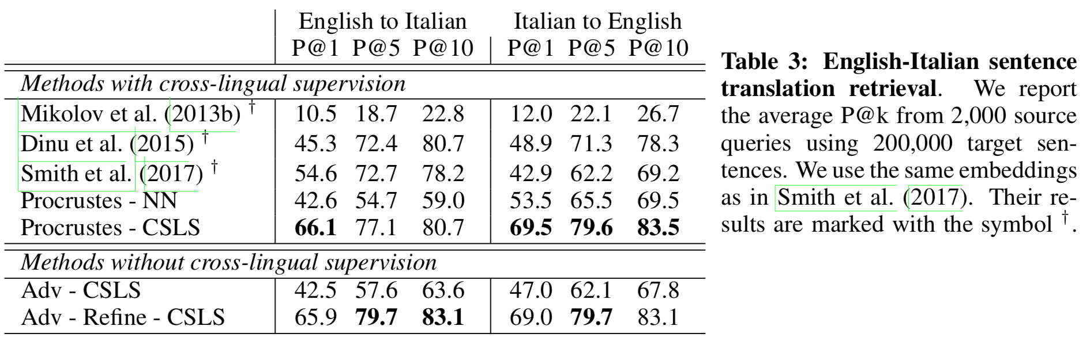
Sentence Translation Retrieval

Slide 55
Unsupervised Cross-Lingual Information Retrieval using Monolingual Data Only
Robert Litschko, Goran Glavaš, Simone Paolo Ponzetto, Ivan Vulić
SIGIR 2018

Slide 56
Overview
Simple Unsupervised Frameworks for CLIR
Leverage shared cross-lingual word embedding spaces
Use MUSE without without any bilingual supervision
Calculate semantic similarity directly from the cross-lingual embedding space
Do not use neural networks relying on relevance labels for supervision.

Slide 57
Cross-Lingual Word Vector Spaces
Different amounts and types of bilingual supervision
Cross-Lingual Embeddings from Comparable Documents (CL-CD)
Cross-Lingual Embeddings from Word Translation Pairs (CL-WT)
Cross-Lingual Embeddings without Bilingual Supervision (CL-UNSUP)
MUSE

Slide 58
Unsupervised CLIR Models
BWE aggregation model (BWE-AGG)
Term-by-term query translation model (TbT-QT)

Slide 59
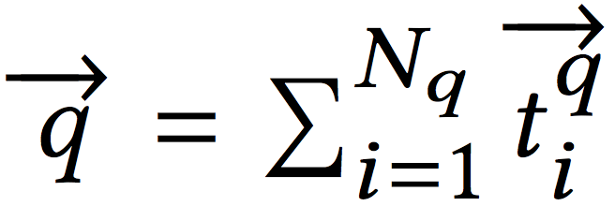
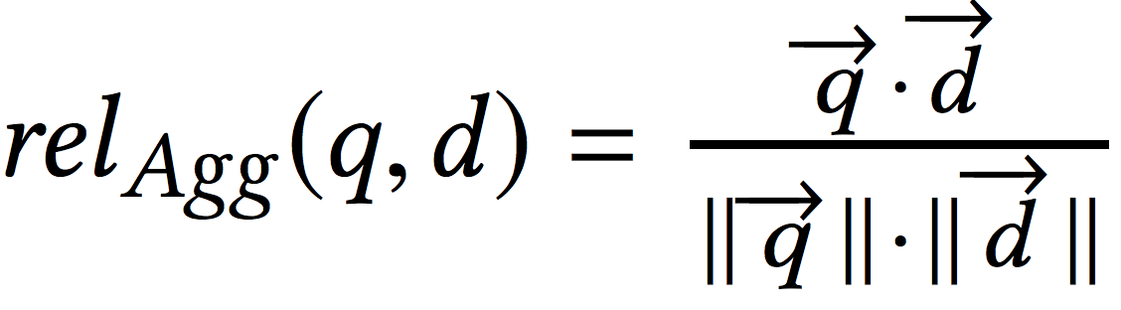
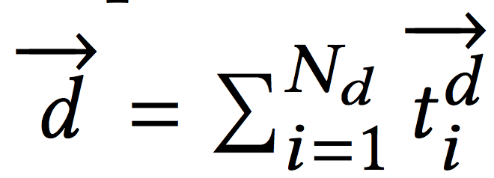
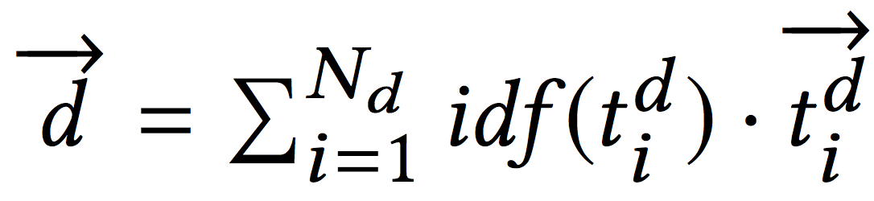
BWE aggregation model (BWE-AGG)
Query
Document
Non-weighted addition (BWE-Agg-Add)
Weighted addition with the term’s inverse document frequency (BWE-Agg-IDF):
Query-Document Relevance

Slide 60
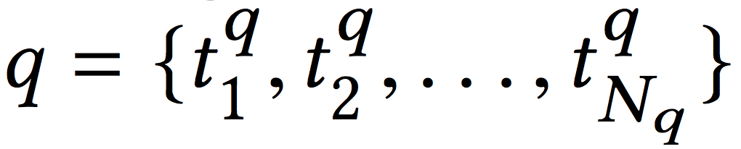
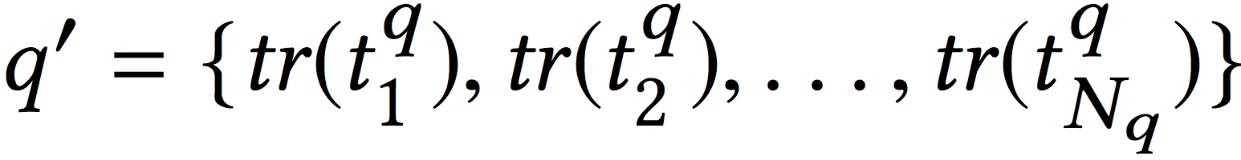
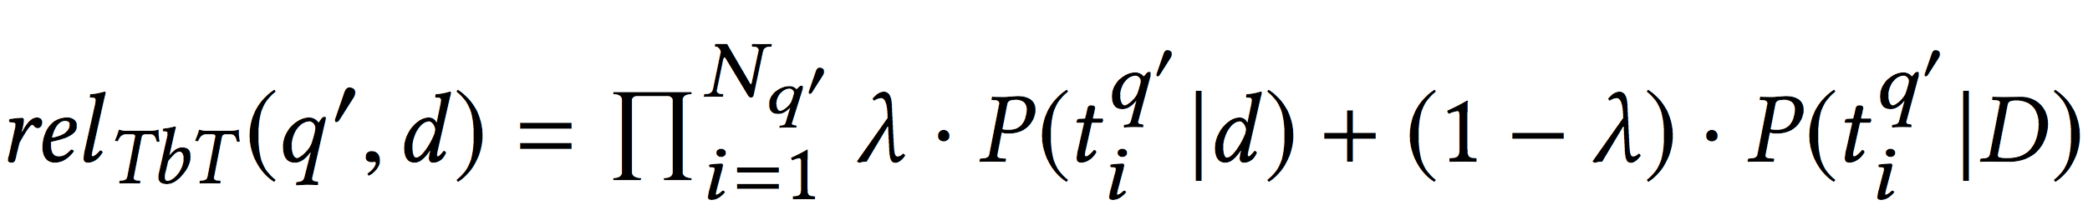
Term-by-term query translation model (TbT-QT)
Do query translation term-by-term based on the nearest neighbour.
query likelihood model

Slide 61
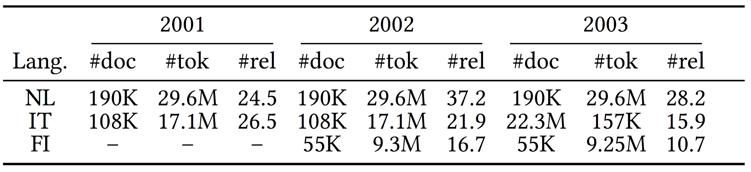
Data Set
CLEF 2001-2003
Query: English (EN)
Document: Dutch (NL), Italian (IT), Finnish (FI)
50, 50, 60 EN queries

Slide 62
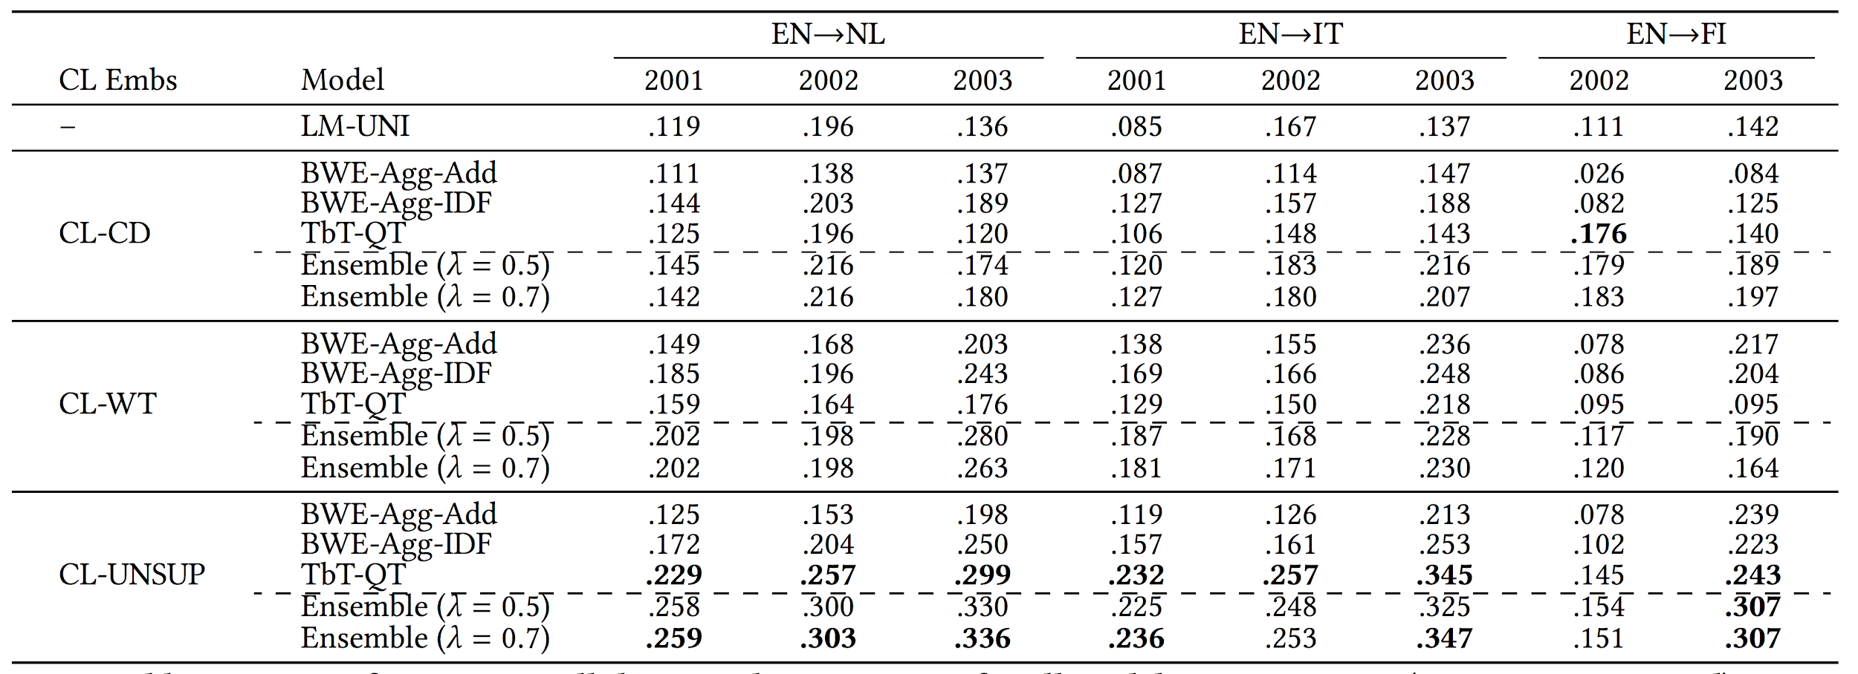
Results

Slide 63
Current Research
Learning Multilingual Embeddings
Unsupervised Multilingual Word Embeddings (EMNLP 2018)
Multi-lingual Common Semantic Space
Multi-lingual Common Semantic Space Construction via Cluster-Consistent Word Embedding (EMNLP 2018)
From crosslingual word embedding to (phrase-based) unsupervised neural machine translation
Phrase-Based & Neural Unsupervised Machine Translation (EMNLP 2018)

Slide 64
Questions
1. Why is adversarial training interesting? Where else can we use it?
2. Where do neural networks struggle in CLIR? Where is the cutting edge?
3. How to improve multilingual embeddings?
4. How to use multilingual embeddings to improve CLIR for MATERIAL?

Slide 65
Questions
1. Why is adversarial training interesting? Where else can we use it?
It is interesting because the supervision is learned
Generative model: GAN
Robust models by adding noise to the input data
Domain adaptation by learning domain-invariant representation
2. Where do neural networks struggle in CLIR? Where is the cutting edge?
Needs lots of training data
Deal with phrases
Incorporate morphology
Domain constraints
Predicting cutoff values
Knowledge Graph

Slide 66
Questions
3. How to improve multilingual embeddings?
Meeting in the middle
Taking into account the multilingual alignments
4. How to use multilingual embeddings to improve CLIR for MATERIAL?

Slide 67
References
Learning to Match using Local and Distributed Representations of Text for Web Search (WWW 2017)
MUSE Word Translation Without Parallel Data (ICLR 2018)
Unsupervised Cross-Lingual Information Retrieval using Monolingual Data Only (SIGIR 2018)
Cross-Language Information Retrieval
An Introduction to Neural Information Retrieval
Neural Networks for Information Retrieval
Neural Information Retrieval: At the End of the Early Years
Neural Models for Information Retrieval

Slide 68
References on Neural IR
Unsupervised Cross-Lingual Information Retrieval using Monolingual Data Only (SIGIR 2018) [code]
Monolingual and Cross-Lingual Information Retrieval Models Based on (Bilingual) Word Embeddings (SIGIR 2015)
Entity-Duet Neural Ranking: Understanding the Role of Knowledge Graph Semantics in Neural Information Retrieval (ACL 2018) [code]
Cross-lingual Learning-to-Rank with Shared Representations (NAACL 2018) [data]
Learning to Match using Local and Distributed Representations of Text for Web Search (WWW 2017) [code]
PACRR: A Position-Aware Neural IR Model for Relevance Matching (EMNLP 2017) [code]
Co-PACRR: A Context-Aware Neural IR Model for Ad-hoc Retrieval (WSDM 2018)

Slide 69
References on Cross-Lingual Word Representations
MUSE Word Translation Without Parallel Data (ICLR 2018) [github][blog]
Babylon - fastText_multilingual Offline bilingual word vectors, orthogonal transformations and the inverted softmax (ICLR 2017) [github]
Learning Crosslingual Word Embeddings without Bilingual Corpora (EMNLP 2016) [github]
Multilingual Training of Crosslingual Word Embeddings (EACL 2017)
Unsupervised Multilingual Word Embeddings (EMNLP 2018) [code]
Massively Multilingual Word Embeddings (multiCluster and multiCCA) (preprint)
Bilingual Word Representations with Monolingual Quality in Mind (bivec) (NAACL 2015 workshop) [github]
Cross-lingual Models of Word Embeddings: An Empirical Comparison (ACL 2016)
Bilingual Embeddings with Random Walks over Multilingual Wordnets (Knowledge-Based Systems, 2018)
Cross-lingual Word Clusters for Direct Transfer of Linguistic Structure (NAACL 2012)

Slide 70
Thank You!

Slide 72
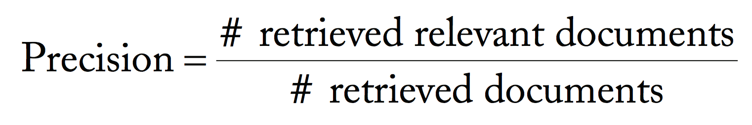

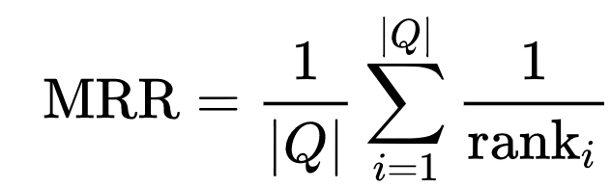
IR Evaluation Metrics
Precision and Recall
Mean reciprocal rank (MRR)

Slide 73
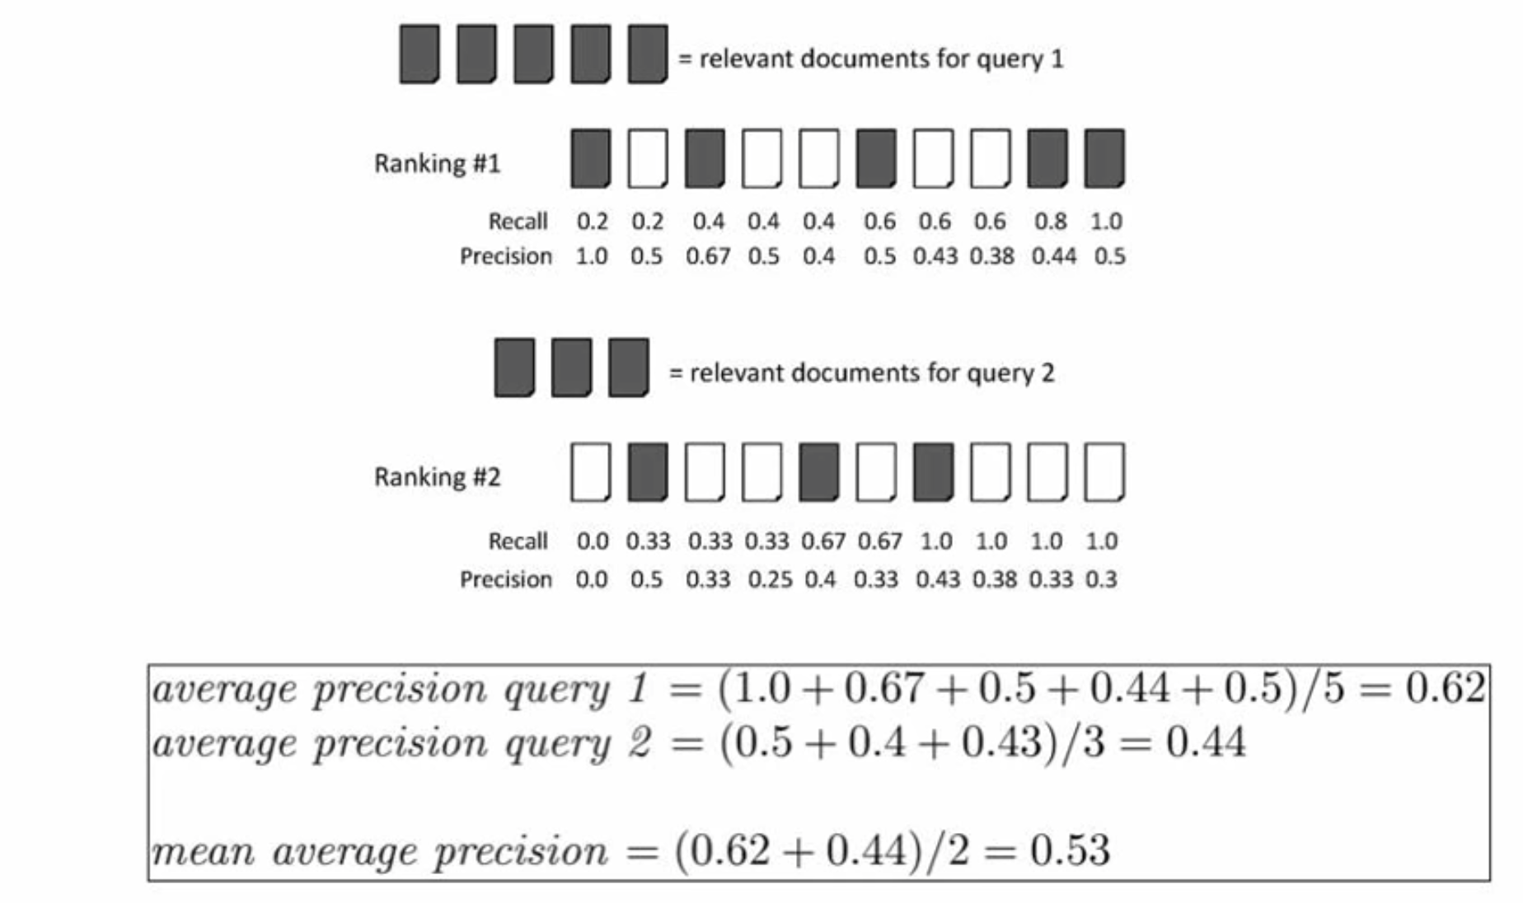
IR Evaluation Metrics
Mean Average Precision (mAP)
https://www.youtube.com/watch?v=pM6DJ0ZZee0

Slide 74
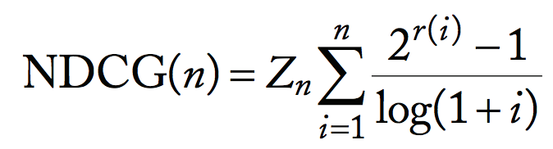
IR Evaluation Metrics
Normalized discounted cumulative gain (NDCG)
Range from 0 to 1

Slide 75
CLIR Data Sets
TREC(Text REtrieval Conference) organized by NIST (the National Institute of Standards and Technology)
Spanish, English, French, German, Italian, Chinese, Arabic
CLEF (Cross-Language Experiment Forum)
Focus on European languages
Indian languages
NTCIR
Focus on Asian languages: Japanese, Chinese, Korean, Vietnamese, Mongolian, and so on.

Slide 76
CLIR Data Sets
MATERIAL organized by IARPA
Swahili and Tagalog
Surprise Language: Somali
WikiCLIR (NAACL 2018)
Use Wikipedia on the same topics in different languages.
Automatic Creation
Query: first sentence of English articles
Relevant Documents: foreign document linked from the English articles.

Slide 77
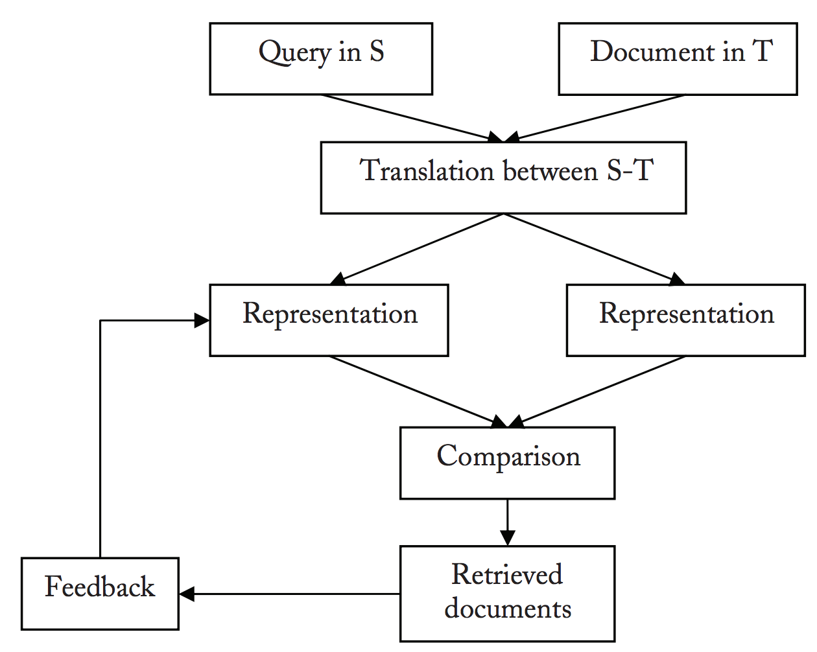
IR and CLIR Architectures
http://www.iro.umontreal.ca/~nie/IFT6255/Books/CLIR.pdf

Slide 78
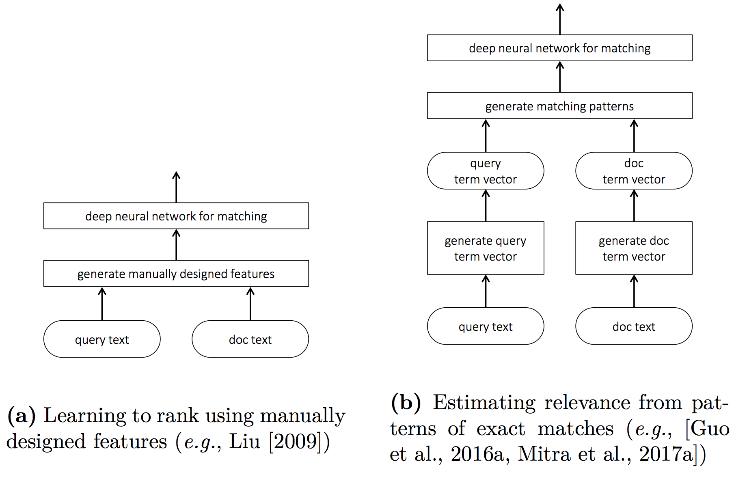
Neural IR Architectures
https://www.microsoft.com/en-us/research/wp-content/uploads/2017/06/fntir-neuralir-mitra.pdf

Slide 79

Neural IR Architectures
https://www.microsoft.com/en-us/research/wp-content/uploads/2017/06/fntir-neuralir-mitra.pdf

Slide 80




Training
Query:
A relevant document:
A set of non-relevant document:
Optimize cross-entropy loss

Slide 81

Orthogonality
Why an orthogonality linear mapping W?
the monolingual quality is preserved.
dot product
L2 distance
Make the training more stable
Alternate the following update with the update of our model
Stay close to an orthogonal matrix

